Slide 1
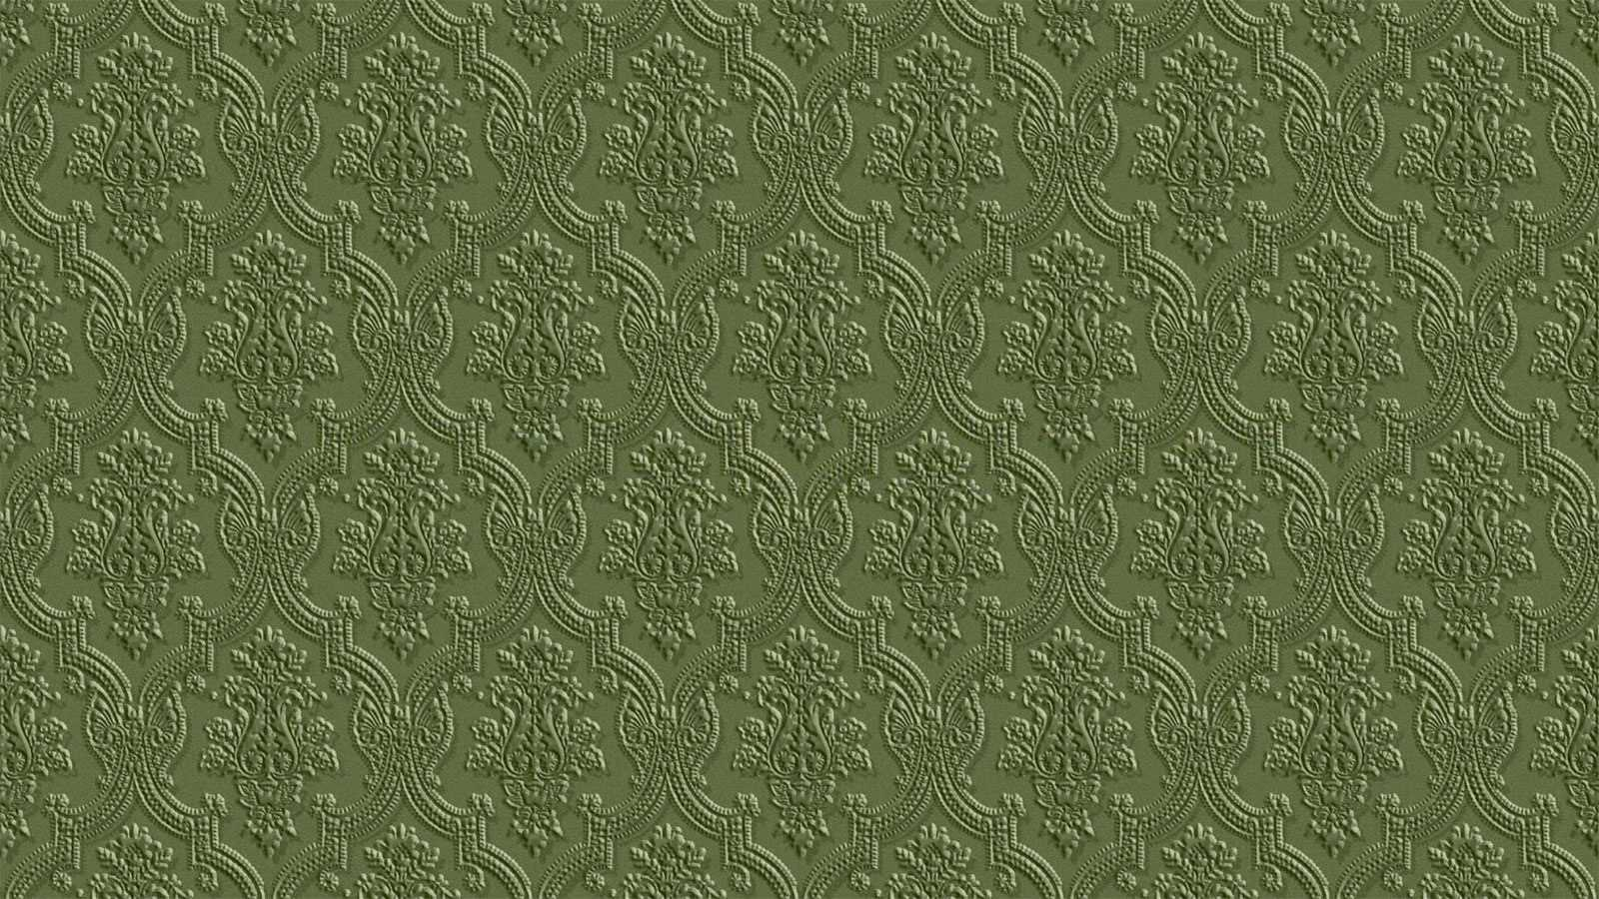
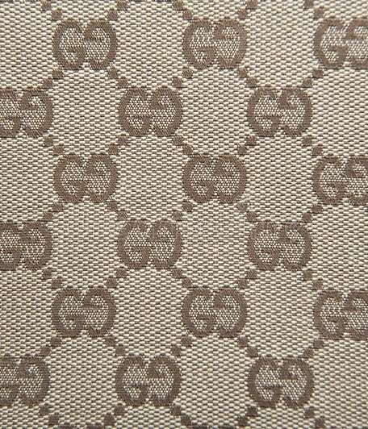
GUCCI
TRADITION & INNOVATION
Josué Gerardo Zozoaga

Slide 2
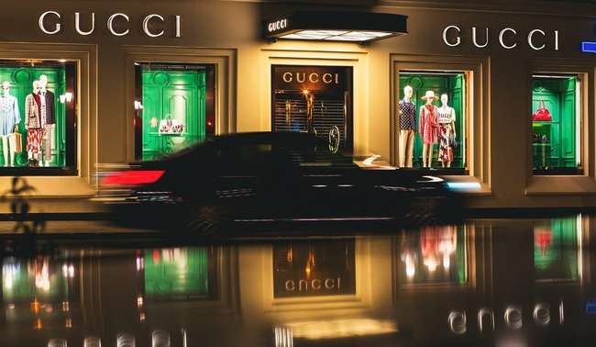
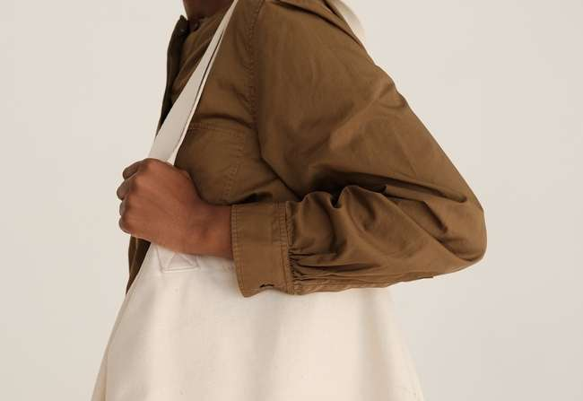
OBJECTIVE
Audit and analyze the existing innovative merchandising features and retail sensorial / experiential atmosphere outside and in-store. More specifically the boutique at 60 Av. Montaigne, 75008 Paris. Then, recommendations will be given in order to improve (or create a new enchanted atmosphere) the existing concept...
Keeping in mind the goal of driving traffic audience to the store, engage the relationship with visitors/clients and client conversion, while delighting the emotional experience of customers so they become loyal consumers and brand ambassadors.

Slide 3
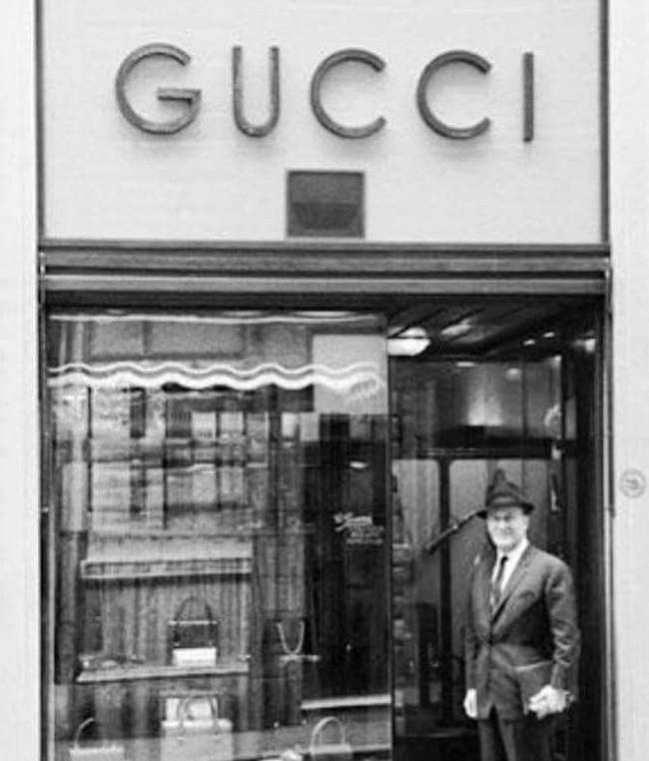
HISTORY
Tradition, charisma, innovation & progress

Slide 4
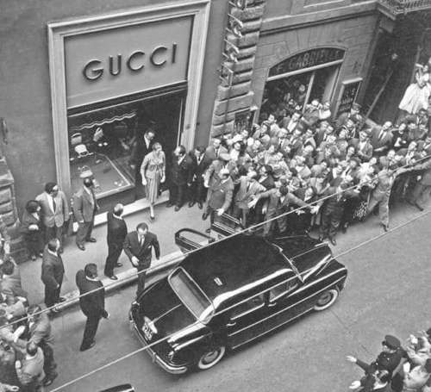
HISTORY
An eclectic, contemporary and romantic brand ... Founded by Guccio Gucci in Florence, Italy in 1921 after having first worked as a porter at the Savoy Hotel and then having worked for Valigeria Franzi.

Slide 5
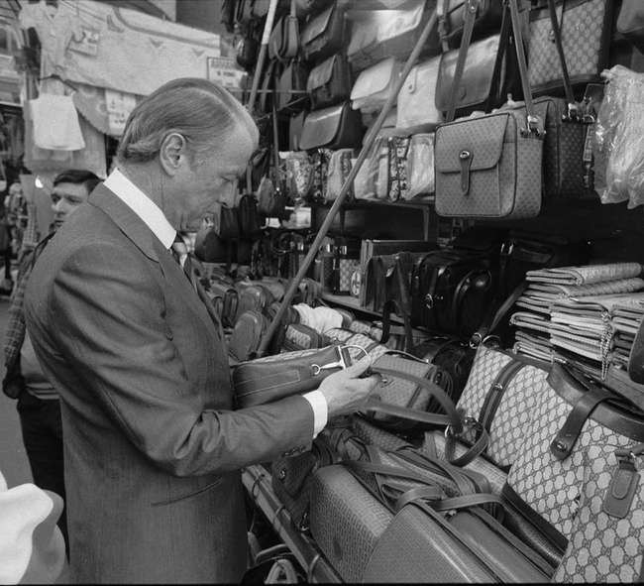
HISTORY
Eventually, Aldo, Vasco, and Rodolfo (Gucci's sons), began working for the company, and continued with the brand expansion and reputation grow. Today and since 2015 Marco Bizarri occupies the CEO position.

Slide 6
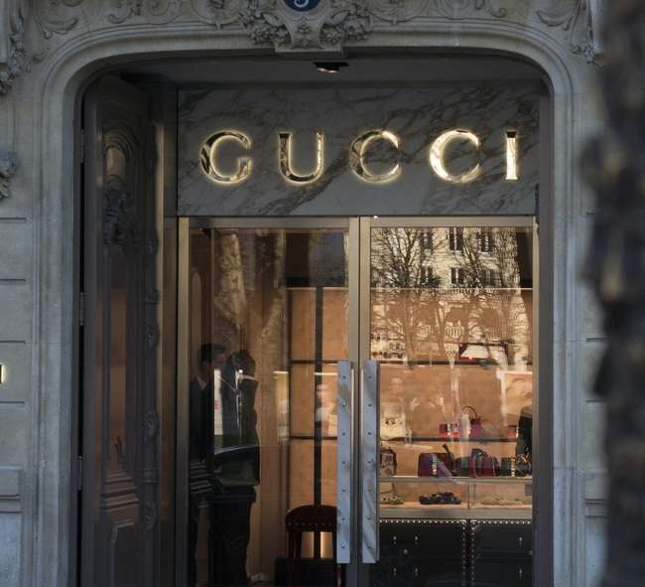
HISTORY
Dynamism, creativity, artistic aesthetic, detailing and luxury ... At first, Gucci primarily sold leather luxury goods and focused on travel items (suitcases and bags). Today, Gucci remains remains a part of the conglomerate Kering.

Slide 7
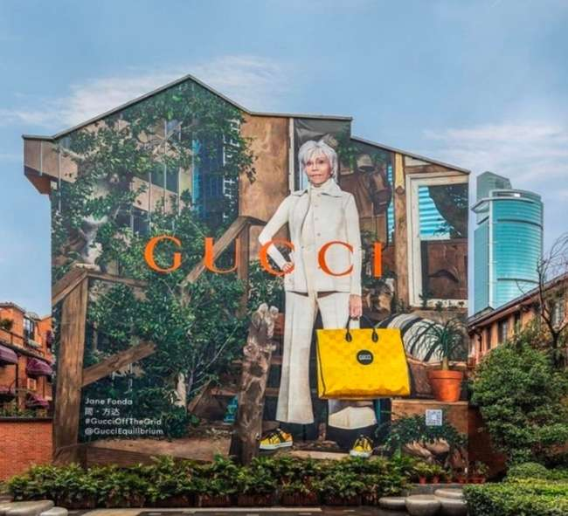
HISTORY
Gucci today is committed to reducing its environmental impact and greenhouse gas emissions by 2025. That’s why Gucci is currently completely fur-free and is embracing season-less fashion.

Slide 8
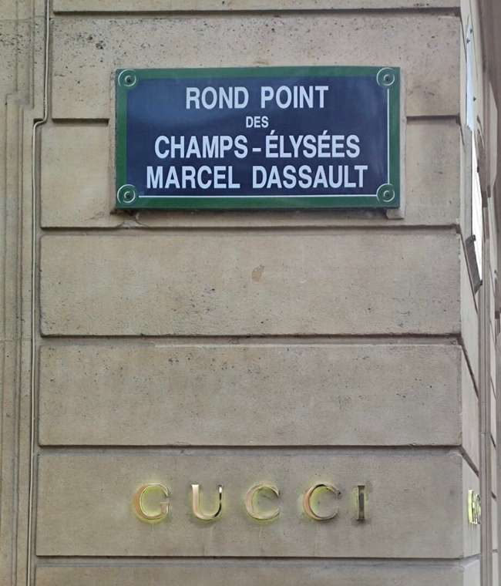
STORE CONCEPT
Color and elegance...

Slide 9
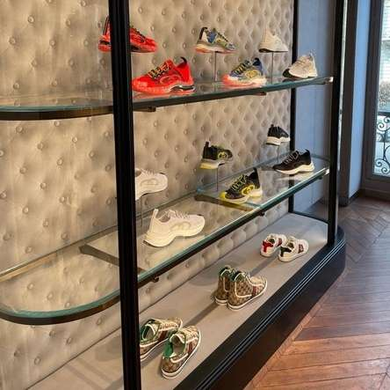
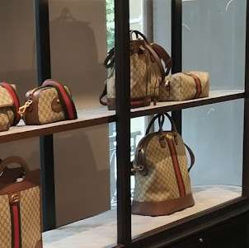
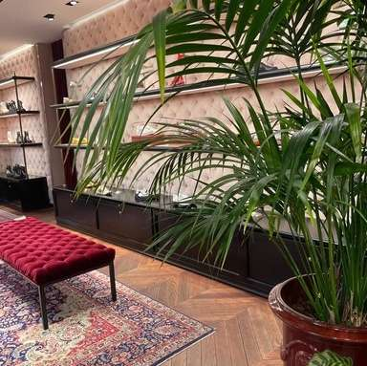
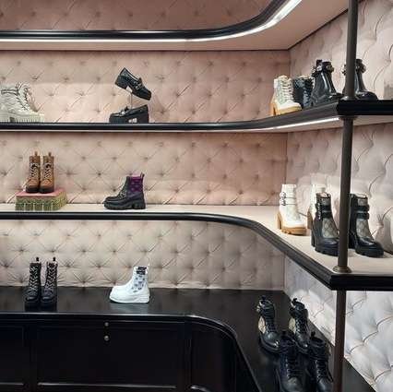
STORE CONCEPT
The store has a colorful but elegant concept with moderate decoration, with the products neatly displayed on shelves with clean design, which does not make it comfortable to look and gives the impression of finding us in an art gallery.

Slide 10
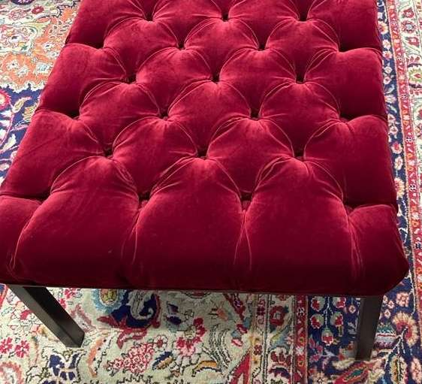
STORE CONCEPT
One can realize the use of decorative (live) plants, wooden floors, carpets, natural light, padded seats and walls, which generates a cozy atmosphere in the store.

Slide 11
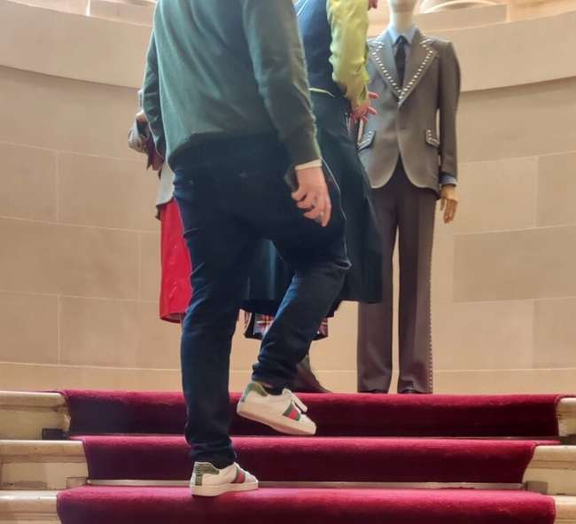
STORE CONCEPT
As for services, since you enter the store there will be someone at the door who will welcome you and assign you a staff member who will give you personalized attention, dedicating himself only and completely to you throughout your stay. It was remarked that some of the staff members are open to have a normal conversation about general topics with clients.

Slide 12
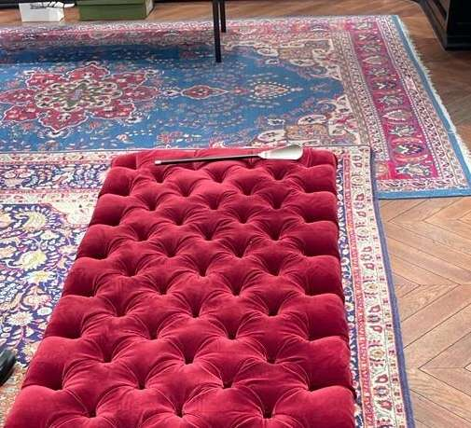
STORE CONCEPT
On the other hand, water is offered to consumers, and a glass of champagne to the most distinguished customers. Each seat shall have a shoehorn to facilitate the testing of the footwear.

Slide 13
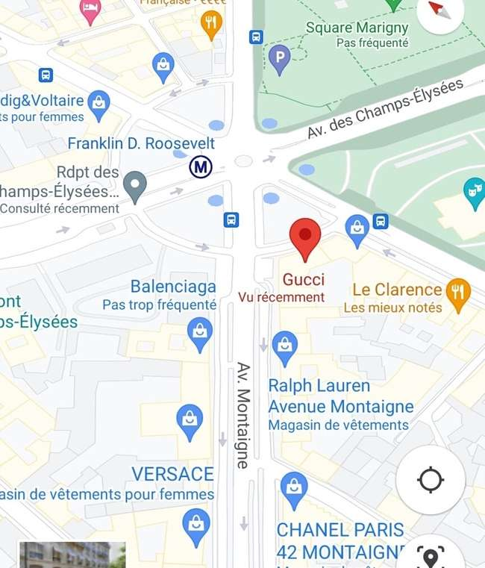
DISTRICT & STREET
Le Triangle d’Or ...

Slide 14
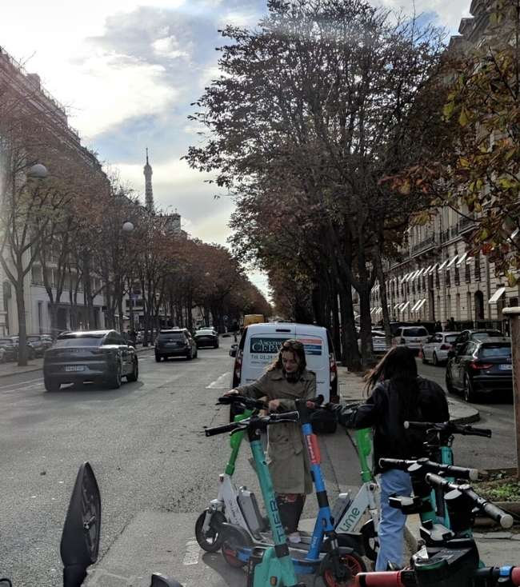
AU 8ÈME
The shop is located within the 8th arrondissement. At the same time, a highly touristic place, and one of the areas where people of high socioeconomic class reside. In the roundabout of Champs-Élysées-Marcel-Dassault, linking Av. de Champs-Élysées, Av. Matignon, Av. Franklin-D.-Roosevelt and Av. Montaigne, and adjoins the gardens of the Champs-Élysées.

Slide 15
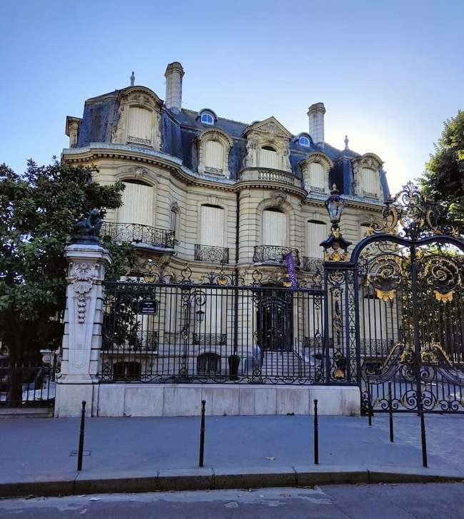
DISTRICT &
STREET
Av. Montaigne links the Place de l'Alma with the Champs-Elysées. It also has a view of the Eiffel Tower, beautiful buildings such as the Hôtel d'Espeyran, restaurants such as Fouquet’s and tourist hotels such as Hôtel Plaza Athénée.

Slide 16
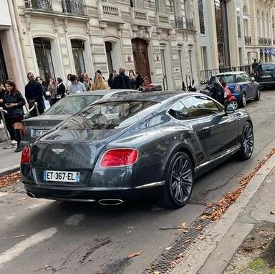
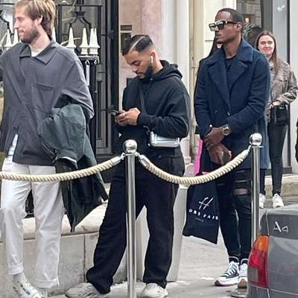
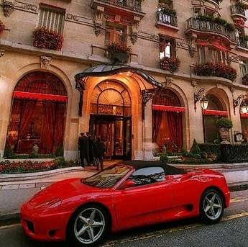
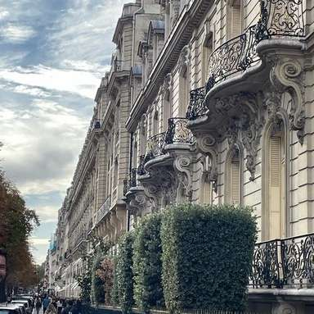
DISTRICT &
STREET
Av. Montaigne is well known for being one of the most elegant and luxurious avenues in Paris. This avenue is one of the edges of the Triangle d’Or, and a great concentrate of Parisian luxury. The real estate price reaches 30,000€ per m2.

Slide 17
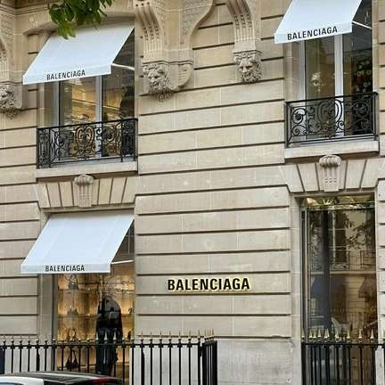
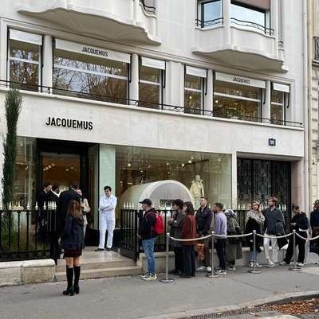
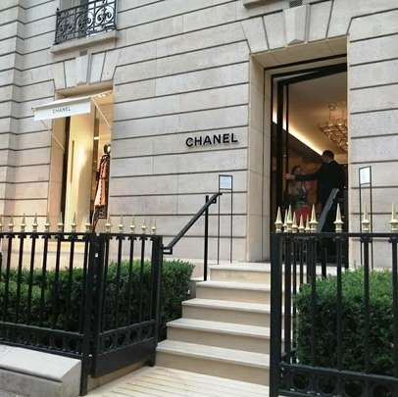
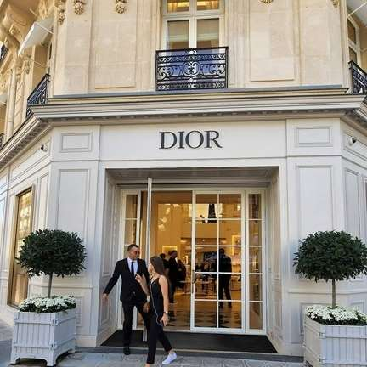
DISTRICT &
STREET
Along the avenue, several luxury brands have been established. Gucci, Chanel, Christian Dior, Louis Vuitton, Chloé, Céline, Thierry Mugler, Saint Laurent Paris, Prada, Balenciaga, Jacquemus, Maison Margiela...

Slide 18

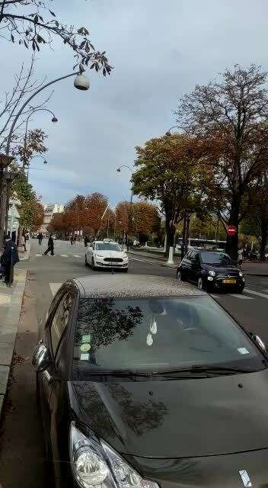
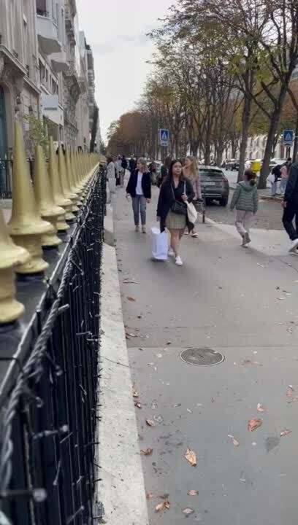
This has attracted tourist movement, but more importantly, from people with a strong interest in the fashion and shopping industry. There is a large concentration of foreigners.
DISTRICT &
STREET

Slide 19
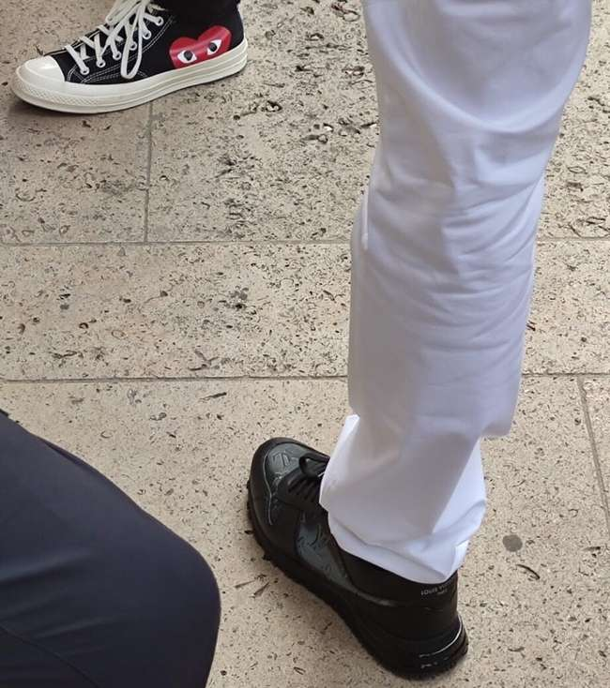
AU 8ÈME
Consumers trained in the different rows of luxury brand stores on the avenue, expected to dress in clothing brands trending and haute couture (Comme des Garçons and Louis Vuitton are seen in the picture for example).

Slide 20
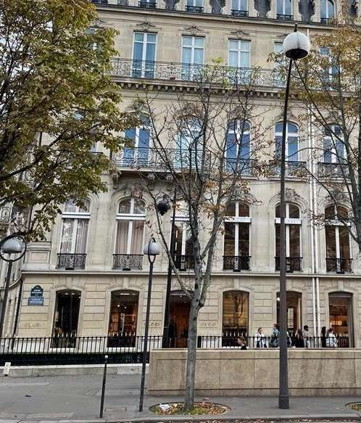
EXTERIOR
A view from the outside...

Slide 21
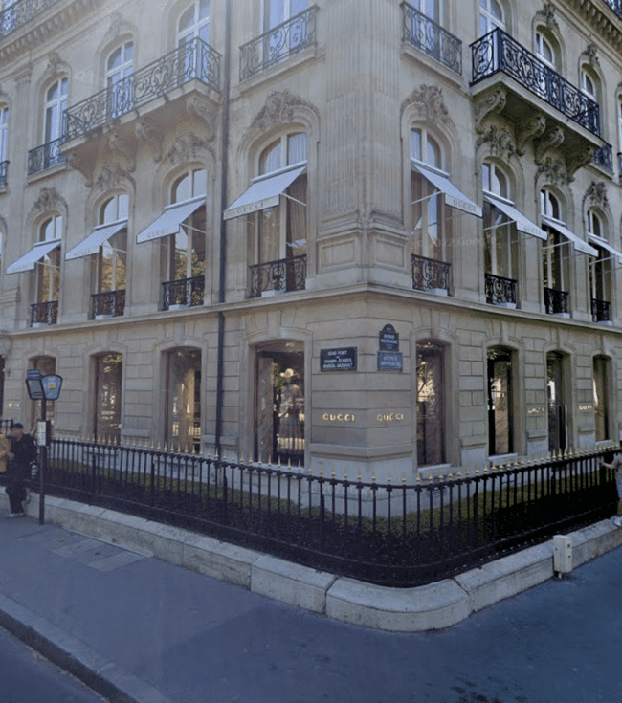
EXTERIOR
The boutique, located at the corner at the end of the avenue and in the middle of the roundabout, has visual exposure for cars and pedestrians going in the direction of the Champs-Élysées, the Arc de Triomphe or the Place de l'Alma.

Slide 22
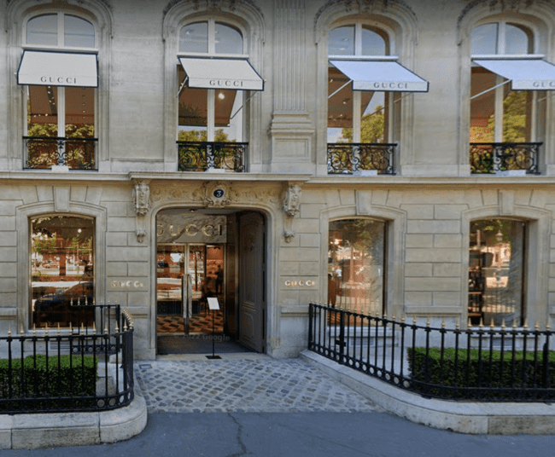
EXTERIOR
The shop has 2 doors for visitors, one dedicated exclusively to the entrance (on the side of Av. Montaigne) and the other to the exit of customers (on the side of the roundabout, shown in the image). Both in front of metro access and bus stops.

Slide 23
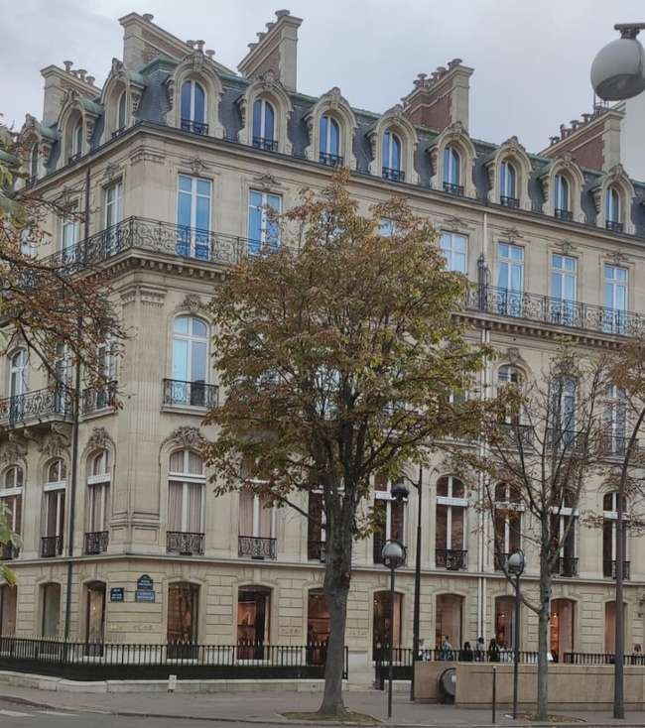
STORE
FRONT
The building where it is located has an architectural style called Haussmannien (created by Eugène Haussmann). This style involves facades built of cut stone with linear precision.

Slide 24
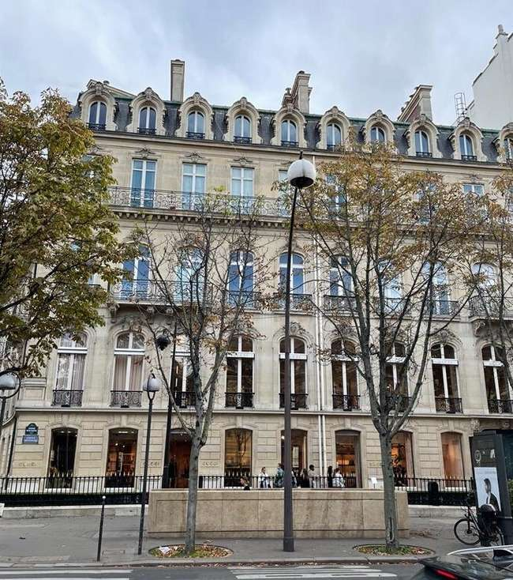
STORE
FRONT
This architectural style is perfect to promote an elegant but classic image while preserving a French identity of the place. In order to better suite with the architectural design of the avenue, Gucci and many other fashion brands on the avenue have decided to maintain the characteristic Parisian style.

Slide 25
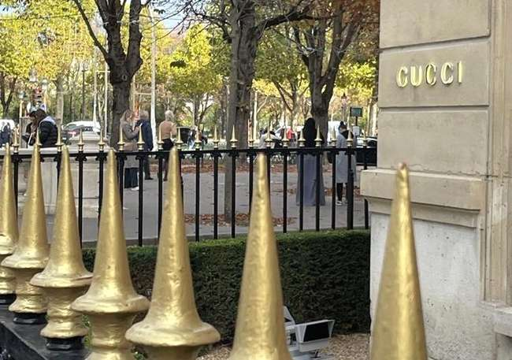
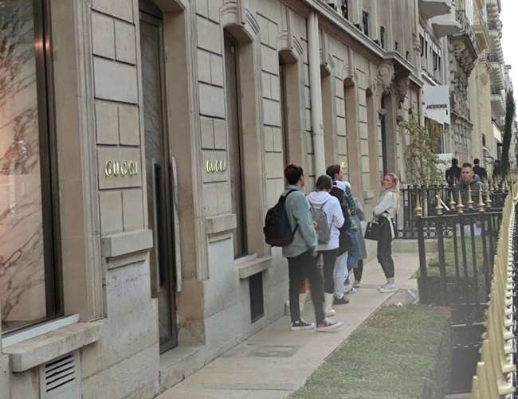
Around the building, forming part of the decoration and delimiting the sidewalk with the outer limit of the store, is a high fence formed by high rods of black metal with golden tips, something that gives an exclusive and elegant appearance to the building.
STORE
FRONT

Slide 26
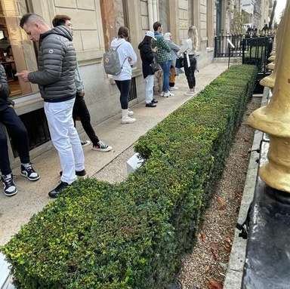
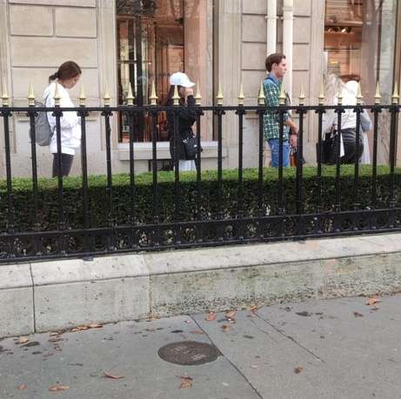
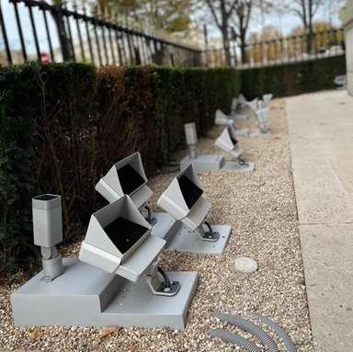
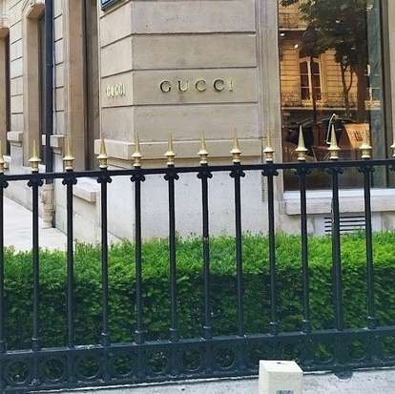
DISTRICT &
STREET
On the inside, the fence is surrounded by a line of green bushes on a stone road. This detail, along with the fence give the appearance of entering a palace. To this we must add the lights on the floor pointing to the building that during night, give the store a certain mystification, appearing a monument.

Slide 27
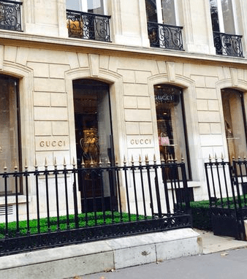
STORE
FRONT
The access to the store is formed by an entrance with a transparent glass door, giving a more contemporary design. This also generates an interesting contrast with the architectural design of the building.

Slide 28
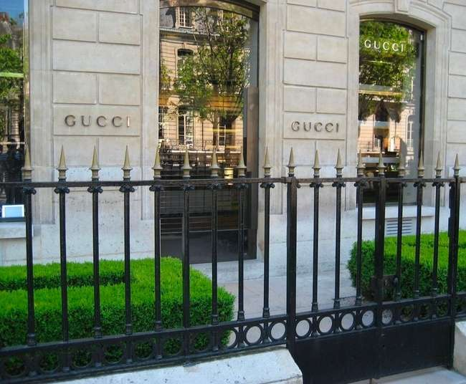
STORE
FRONT
The door is a form of non-verbal communication, because it is much more uncomfortable to approach someone who has the door closed than to find a glazed space that allows eye contact.

Slide 29
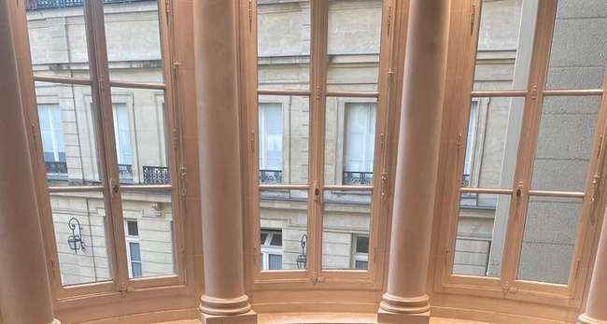
STORE
FRONT
Together with the fence and external decoration, it favors the approach of a sector of consumers with a desire to feel that an exclusive space enters where it feels comfortable and important.
In addition to the transparent door, the existence of windows contributes to the entry of natural light and allows the view inside the boutique. Generating a more pleasant stay that favor communication and well-being.

Slide 30
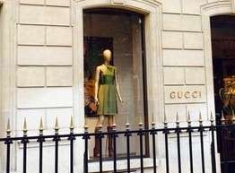
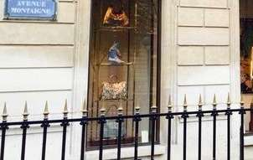
Window displays are a strategic tool in visual communication and marketing. They can function as an advertising, promotion and attraction tool that forms the basis of a competitive advantage. They can and should be used as well to tell a story to the clients that may attire their attention.
WINDOW
DISPLAYS

Slide 31
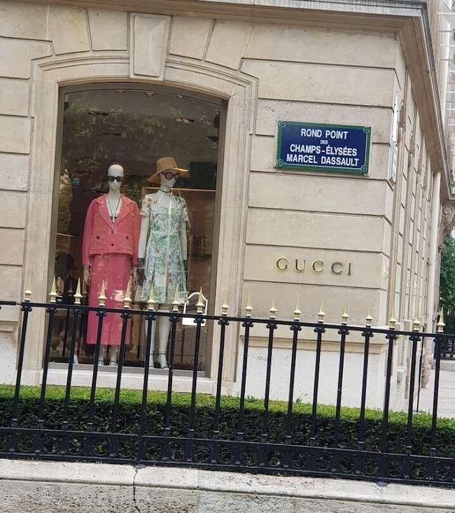
WINDOW
DISPLAYS
Studies suggest that it is possible to influence the emotional effects that window displays have on the public by constantly altering its composition and using visual, esthetic elements. Novelty, dynamics and structure create pleasant feelings, what can be used to attract consumers and invite them to enter the store.

Slide 32
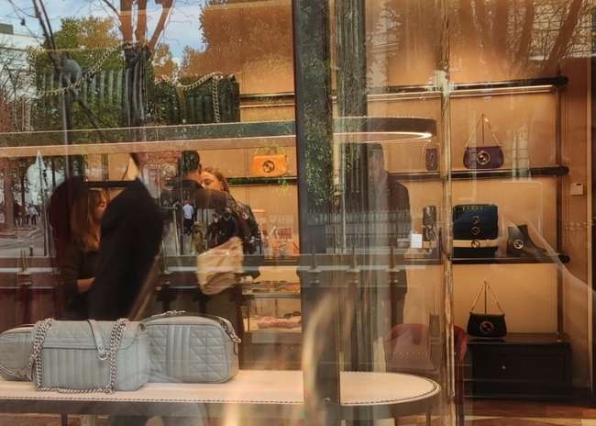
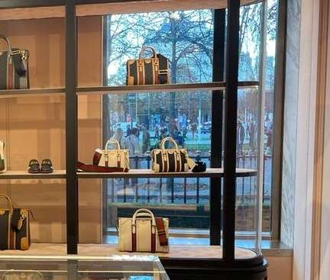
The window displays of this establishment vary throughout the year in terms of the products shown and the bottom of them. On the visit made at the end of October, the background of all the window displays were open.
WINDOW
DISPLAYS

Slide 33

WINDOW
DISPLAYS
Judging by what was observed during the visit, the window displays were featuring similar products and a cross mix of items (outfits). As expected, the outfits displayed are according the season of the year (fall).

Slide 34


The rule of visual merchandising 1/5/Z/3 refers to the concept of distributing items or products in a window display forming a Z shape as a set of one, three or five to spark an interest or to catch the viewer's attention and layering on the accommodation. When customers see products in groups of one, three or five, it encourages the eyes to look around and see the details within the display. Many luxury fashion brands like Dior have been seen not caring about dis rule and displaying a pair number of items though… Sometimes, we shall remember that luxury is about creating our own rules and identity.
WINDOW
DISPLAYS

Slide 35


WINDOW
DISPLAYS
When using the 1/5/z/3 rule, to this number of displayed elements is added the use of the Z-Pattern for the order in which they will be placed. This pattern design traces the route the human eye travels when they read or scan an image left to right, top to bottom.

Slide 36

WINDOW
DISPLAYS
In this establishment Gucci does not seem to be interested on on implementing this type of display. As seen in previous images, it does not necessarily use the number of items, nor the Z-Pattern that the visual merchandising rule requires.

Slide 37
INTERIOR
A view from the inside...

Slide 38

MERCHANDISING
PRACTICES
A very useful merchandising practice observed in the store is the use of QR codes distributed in different places of the store according to the distribution of product display areas (jewelry, shoes, collaborations, etc.).
Such is the example of the display of the clock shown in the image on the right.

Slide 39

MERCHANDISING
PRACTICES
Another merchandising strategy used correctly in-store are mannequins. Exploited in the promotion of new collections and collaborations, as well as in cross-selling products. They are arranged in such a way that they reach balance between simplicity, style and interaction with the environment (hand on the display case).

Slide 40
SENSES
The responses to the senses and non-conscious stimuli affect strongly the deepest parts of our brains and influence buying behavior. The fact that physical shops can appeal to the 5 senses of the consumer give them an advantage over online sales.

Slide 41

SIGHT
One way in which visitors are stimulated is through eye-catching decoration. In Gucci Av. Montaigne a combination of a Victorian style with a modern and contemporary style is used. At the same time in the interior design and in product displays on the shelves. Instilling in the atmosphere a touch of contemporary romanticism.

Slide 42

SIGHT
Furnishing, color choices and strategical lighting are part of customer's in-store visual experience. Together they are responsible both for transmitting the image and brand values, and for influencing the consumer’s mood through the atmosphere created. These elements also play an important role in key retail moments such as whether a client looks at an item/display or not.

Slide 43

SMELL
As for the use of fragrances in the environment both inside and outside the boutique, the use of any essence or smell was not detected. No unpleasant odor was noticed either. Therefore, the shop possessed an unforgettable fragrance, from my point of view, this is a great area of opportunity to improve and exploit the sense of smell.

Slide 44

SMELL
However, the way that the in-store customer’s sense of smell is stimulated is through The Alchemist’s Garden booth during the shop tour, where it is possible to smell the different complex and elegant fragrances of Gucci in an aesthetic way by raising the glass bells in front of each bottle of perfume and bowing to the front to smell.

Slide 45

EAR
Music can be heard in the background with a low-moderate volume that favored the creation of a lively and glamorous atmosphere. We asked the staff members if they oversaw choosing the songs, but they said they are not.

Slide 46

EAR
During my visit to the boutique, I had the task of discovering the background song. The song at the time was "Standing Right Here" by Melba Moore of R&B genre, a soft, relaxing and soulful genre.

Slide 47

TOUCH
The shop has fitting rooms that allow you to freely feel the clothes with your hands and body. It is possible to enter with the amount of clothes you want, and the staff will be there to assist you in case you need assistance or some other garment.

Slide 48


It is possible to touch and test each item in the store, from the bags displayed on the shelves to the jewelry items. The staff will arrange for the necessary size.
TOUCH

Slide 49

TASTE
As for the sense of taste, during the tour the staff will offer themselves to bring you a glass of water and refill it if you wish.

Slide 50

TASTE
Staff members will also offer to bring a glass of champagne and refill it as many times as desired to the most distinguished customers.

Slide 51

GREEN MERCHANDISING
As for the green merchandising strategies implemented in the boutique. Plants of various sizes are seen in elegant pots distributed throughout the store.

Slide 52

GREEN MERCHANDISING
The green color contributes to the colorful atmosphere of the place and the fact that they are real plants causes a sense of comfort and life.

Slide 53

DIGITAL TECHNOLOGIES
En cuanto a las tecnologías implementadas in-store, se observa el placement estratégico de códigos QR para la presentación dinámica de productos. Bastará con escanearlos para ver un breve video sobre el producto.

Slide 54

DIGITAL TECHNOLOGIES
Another use of technology observed is iPads as a sales and information tool for staff. These are distributed in the different sections of the store. Generally, it is the staff who use them to show different information to the customer about a costumer. Staff members have been seen using them to refer the clients to the online store too.

Slide 55

RETAIL-
TAINMENT
In the Gucci flagship Av. Montaigne was not observed at the time of the visit made any retailtainment activities, but in its mobile application. A completely entertaining and immersive experience that can be merged with the in-store experience in the Try-On section of the app.

Slide 56

BOUTIQUE'S
MAP
Understanding the inside...

Slide 57

BOUTIQUE'SMAP
The image shows the ground-floor of the boutique. An important detail that is identified in the accommodation of the sections of the store is that right at the entrance are the bags displays (brand’s star product), which are of course the Jackie and Bamboo.

Slide 58

This image shows the second floor of the shop. The highest concentration of QR code was dedicated to the section on the left with the jewelry display cases. Also, immediately when climbing the stairs was a colorful ledge with attractive Gucci branded items and an individual sofa to rest.
BOUTIQUE'SMAP

Slide 59

SOCIAL
MEDIA
Understanding the inside...

Slide 60

BOUTIQUE'S
SOCIAL MEDIA
The Avenue Montaigne Gucci Flagship store has no special social media account. Being that this PoS is a flagship store and is in a popular and luxurious zone of Paris, creating a special account for this specific store would be a good tool to improve the customer experience.

Slide 61

BOUTIQUE'S
SOCIAL MEDIA
They could organize online retailtainment activities along with their social media accounts, such as finding hidden items at a specific time and sharing a story or post, tagging the boutique, or small glamorous shows.

Slide 62
RECOMMANDATIONS
Making Gucci great again...

Slide 63

RECOMMANDATIONS
In my opinion this boutique has a lot of potential for improvement. Starting from the outside, I would recommend making a more creative use of windows. Not all of them even had window displays. I would implement the 1/5/Z/3 rule (understanding eye scanning patterns) to tell a story to clients, as well as including a plaque at some of the lower ends with the prices of the displayed items.

Slide 64

RECOMMANDATIONS
Customer experience is an important factor while creating loyalty and inviting visitors to come back to the store. Improving the experience while waiting in line to enter the boutique using music that matches the atmosphere created inside the store (gender, tempo & volume).

Slide 65

RECOMMANDATIONS
To dare… Expressing brand identity or collections in creative, striking and unconventional ways. Something that even harmonizes with Gucci’s brand identity.

Slide 66

RECOMMANDATIONS
The store inside had no distinctive fragrance. Using a signature scent, even if it is a simple smell, would certainly make a difference by positively influencing the mood of visitors, who would be likely to spend more time in the store, and link it with that smell and what it made them feel.

Slide 67

RECOMMANDATIONS
In the flagship store of the Montaigne avenue, Gucci has implemented some QR codes strategically. In my opinion they can further exploit this tool by placing small plates with QR codes next to the mannequins (showing information about the items they wear).

Slide 68

RECOMMANDATIONS
Few brands like Jacquemus (popcorns) offer food/snacks to visitors. As Gucci is a brand that seeks to differentiate itself through the customer experience it is quite essential to take a step ahead improving the customer’s taste experience. Macarons are an amazing option to do it, as a famous and broadly consumed dessert adopted by French pastries, being the chosen for this analysis is in Paris, France.

Slide 69

RECOMMANDATIONS
Offering a glass of water to customers has become a staple in luxury boutiques. Even offering a glass of champagne is common in these types of stores. Another way to enhance the sensory experience of customers by appealing to a sense of taste would be to add a small cup of coffee to customers.

Slide 70

RECOMMANDATIONS
The integration of additional in-store technologies is critical to a high-level shopping experience. They should go beyond the use they currently give their App and QR and develop an augmented reality experience in-store, being able to see details/information of a broader variety of products with their cell phone.

Slide 71

RECOMMANDATIONS
A good strategy would be to enable an in-store augmented reality feature from the app as well, and not only being able of virtually visualize some products on ourselves. Gucci could give their app a retailtainment use by personalizing the display depending on the store the consumer is located in.

Slide 72

RECOMMANDATIONS
To discover the effectiveness that entertainment could have in their stores. An example is that of the restaurant Salvaje Paris, which shows periodic dancing performances in the middle of the eating area during the night. When it comes about luxury, innovation, hospitality and retailtainment, I think we should not be afraid to have a look across industries that target the same niche that we as a luxury brand do.

Slide 73

RECOMMANDATIONS
Gucci is doing very well with its experiential App; however, the integration of a virtual store seems to me essential to stay current as one of the leading luxury brands in the fashion industry. As Dior and Moncler have done. Obsess is an example of platforms for the development of this type of virtual stores.

Slide 74

RECOMMANDATIONS
A great customer value-adding resource would be to merge a virtual store with the augmented reality in-store, placing collectible digital items throughout the store that can be exchanged for points in the store that are interchangeable for discount codes or even gifts for the most distinctive customers.

Slide 75

A LOVE BRAND / BOUTIQUE ?
Understanding the inside...

Slide 76




LOVE
BOUTIQUE?
The beautiful, colorful and changing decoration has captivated some of the flagship store customers on Avenue Montaigne. They have let it us know on their social networks using the brand’s hashtag and including the hashtag #gucciavenuemontaigne.

Slide 77

LOVE
BRAND?
Gucci’s identity as a high fashion, luxury and class brand, as well as the presence in the eye of the consumer through collaborations with other brands and big celebrities have allowed them to gain a strong status and generate an emotional-aspirational bond with his customers.

Slide 78

LOVE
BRAND?
The brand seeks to extend their link with its customers outside their stores and social networks through its mobile application integrating podcasts and arcade games.

Slide 79

GUCCI
AMBASSADOR
The design of the shop creates a pleasant and emotional atmosphere, though personally I would not consider myself an ambassador of the shop. To conclude, I suggest integrating more appealing and innovative experiential merchandising tools could be integrated.

Slide 80

GUCCI
IMAGINING A POP-UP STORE
Josué Gerardo Zozoaga

Slide 81


ATMOODSPHERE

Slide 82


Gucci-sphere
The atmosphere that Gucci maintains is colorful but elegant, maintaining an eccentric personality with traces of elegance. They use models and mannequins dressed in a stylish and elegant way with several elements on them (contrary to a minimalistic appearance), but transmitting a laid-back image, creative and colorful at the same time. This makes Gucci a brand with unusual characteristics and looking to be perceived as such.

Slide 83

GUCCI
HA HA HA
An atmosphere that we would seek to preserve in their establishments regardless of adaptations based on new collections or the season.
To this characteristic atmosphere, Gucci wanted to add a vintage look (70’s) in his latest collection, collaborating with artist Harry Styles for "Gucci Ha Ha Ha". Collection taken into account for this pop-up store proposal.

Slide 84


The staff would be dressed in a uniform compatible with the atmosphere, a suit and/or dress (as decided with the staff who will be in the pop-up store) made in the same way with a loose fit and colorful/vintage look (same color, or different colors for each staff member).
As for personality, it is necessary that they are people who love people, that organically generate conversation and are interested in verbal and non-verbal information that the client has to share with us.
PEOPLE WHO LOVE PEOPLE

Slide 85

AROMA
As for the sensory atmosphere, it is strongly linked to the mood in impact on the mind of the customer Starting with the aroma, Gucci would like to use complex fragrances with fresh, floral, romantic and citrus characteristics (creativity, amplitude and freedom).
For a better understanding of the impact of the 5 senses on the consumer’s mood and luxury marketing, we recommend reading The Neuroconsumer by Bayle-Tourtoulou Anne-Sophie, Badoc Michel.

Slide 86



SIGHT
As for the sense of sight, it is stimulated by a vintage, elegant, romantic decoration, mixing retro and modern elements, such as intelligent screens where clients could see products on their selves.
Floral prints, wood (elegance), wicker (calm), biophilic design (oasis effect), antique phones/record player (nostalgia), colorful curtains and carpets (eccentricity). It would be interesting to integrate a space like the image on the right with books that customers could leaf through.

Slide 87


HEARING
As for the sense of hearing, naturally you think of the use of Harry Styles songs to be the image of the collection, but also songs like BEST INTEREST by Tayler, The Creator, or Soul of the 70’s. This Spotify playlist is a good example: https://open.spotify.com/playlist/37i9dQZF1DWULEW2RfoSCi?si=7RYwi22DTze5AER4MIs4vw&utm_source=copy-link&nd=1

Slide 88




TOUCH
As for the sense of touch, it is stimulated through the fine furniture and the existence of fitting rooms so that the customer can feel in his body and with his hands the products that interest him. On the other hand, a tool to generate empathy with the client is the physical contact staff-client (client-client on the contrary is harmful). A slight organic touch on the shoulder on the tour or the conversation, a handshake when greeting and saying goodbye. To get the most out of it it is important that staff know the rules of physical contact in different cultures.

Slide 89


TASTE
As for the sense of taste, to offer small pieces perfectly cut/presented tropical fruits and red fruits to customers (regulation of emotional processes and generation of endorphins), water and a glass of fine champagne for the most distinctive customers. Should not hesitate to consult local trends and eating traditions/habits.

Slide 90

24 ºG
Air conditioning temperature adapted to the outside temperature. The programmed temperature must not exceed 12 degrees apart from the outside temperature. Ideally, about 24 or 25 degrees Celsius would be enough to convey comfort.
For this pop-up store proposal, the most recent collection of Gucci was taken as a reference, but it is recommended to follow a similar scheme for upcoming collections with their respective personalities and atmospheres.

Slide 91


LOCATION

Slide 92



NY vs London vs Paris
For this pop-up store, New York seems to be the ideal destination to establish it. 27% of Gucci’s global revenue in 2021 originated in North America, versus 17% in Western Europe. Harry Styles is more heard in US than in France, in addition, in 2012 he confessed that NY was one of his favorite cities, which could facilitate that a visit organized to the Pop-up store by the artist can take place at least one occasion.
®STATISTA 2022

Slide 93


DISTRICT
Located more precisely in the Midtown neighborhood. Iconic department stores, electric thrill, designer flagships, and a traditional luxury experience. Establishments and attractions in this district are thought of as a valuable tool to generate joint synergies and capture customers.

Slide 94


DISTRICT
We embedded ourselves in the tourist epicenter of Manhattan. Times Square, famous buildings such as the Chrysler Building, the Empire State Building and the Flatiron Building, near Central Park, attractions for art lovers, the Grand Central Terminal and culminating with the big luxury signs of 5th Avenue.

Slide 95

JOINT SYNERGIES
As for the stores that would serve as a collection tool. Think of establishments like Forty-Five Ten, Christian Soriano The Curated, Want Apothecary, Dover Street Market, Fivestory, Nordstrom and The Conservatory. Sharing features such as a taste for luxury, color, cutting edge designs and use of technology such as (Nordstrom virtual mirrors).

Slide 96


CUSTOMER
CAPTION
As for places to eat, visit and stay. Think of Legacy Records restaurant with Mediterranean food with touches of gold, marble and mahogany in the decor, in places like MoMA, SPYSCAPE and AKC Museum of the Dog, and in luxurious hotels like The Times Square EDITION, The Plaza and Hotel St. Moritz

Slide 97

GUCC
E-COMMERCE
NY was chosen as the ideal location for the physical store of this pop-up store, but a virtual store in addition to the physical point of sale is another great strategy that the company can use to delight its customers who are passionate about this new collection in all parts of the world.

Slide 98


GUCC
E-COMMERCE
This virtual pop-up store can be used unlimitedly by adapting it to new collections and collaborations. Increasing their exposure in certain areas of the world, according to the KPIs used in their marketing strategy. An example of virtual pop-up store is the one of Moncler x Mytheresa. One option for creating this online store is the Obsess platform.

Slide 99


THANK YOU
PRIORITIZE EXPERIENCES

